Slide 1
Project Report: Customer Segmentation Using Machine Learning
Bilgan Kiriş

Slide 2
Introduction
This project aimed to explore customer segmentation by predicting customer segments based on their attributes. Our primary goal was to utilize machine learning models to identify distinct customer groups accurately and derive actionable insights to enhance business strategies.

Slide 3
Dataset Overview
We worked with a dataset containing demographic and transactional details of customers. The dataset consisted of 929,615 entries with 30 columns. Key attributes included customer age, income, residency status, relationship type, and customer segmentation categories

Slide 4
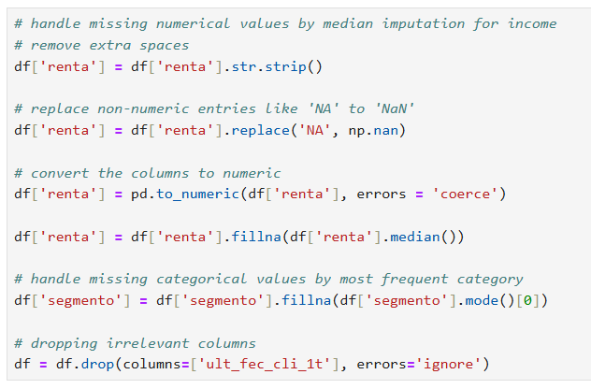
1. Data Cleaning and Transforming
Missing Values: Missing values in certain columns were replaced with meaningful defaults. For instance, missing renta (income) values were filled with the median income to maintain consistency without introducing bias.
Data Transformation:
Created new columns such as renta_log and age_log by applying logarithmic transformations to reduce skewness.
Standardized income values using z-scores to ensure comparability.
Encoded categorical features like segmento into numerical values to make them machine-learning compatible.
Feature Selection:
We analyzed correlation and dropped less relevant columns. Key features like age, income, and relationship type were retained for prediction.

Slide 5
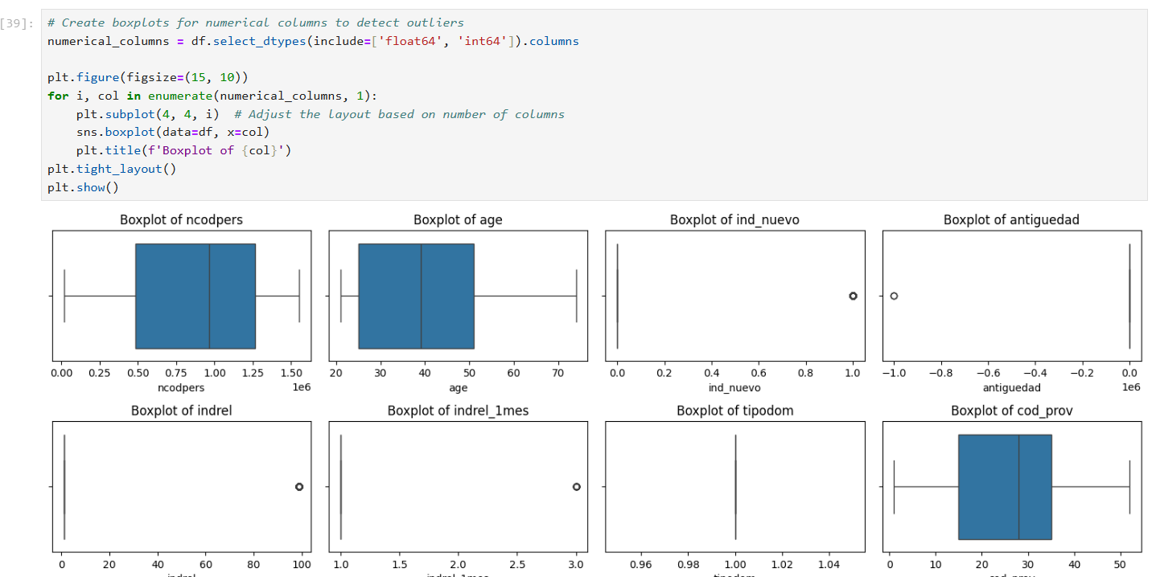
Outlier and Skewness Check

Slide 6
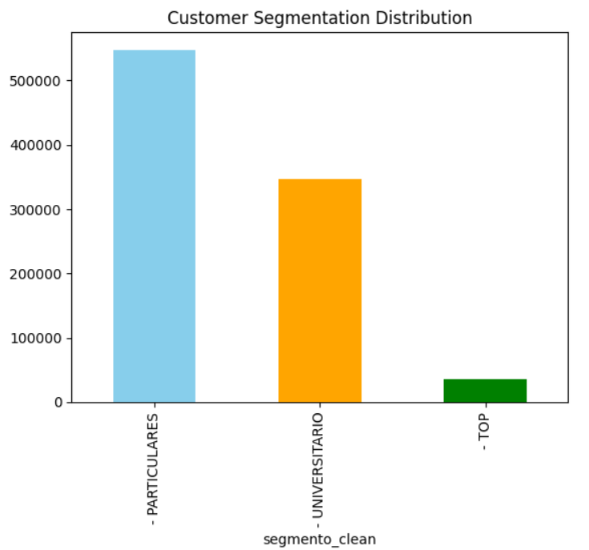
2. Exploratory Data Analysis (EDA)
Understanding Data Distributions: Histograms and boxplots were used to inspect age and income distributions, identifying outliers and trends.
Segmentation Analysis:
We explored the distribution of customer segments and observed that most customers belonged to the PARTICULARES segment, followed by UNIVERSITARIO and TOP.

Slide 7
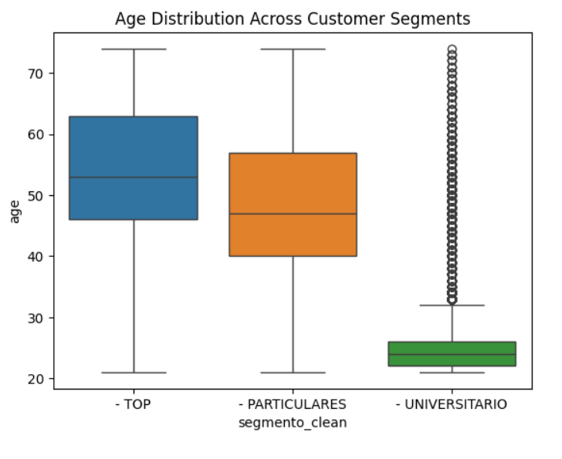
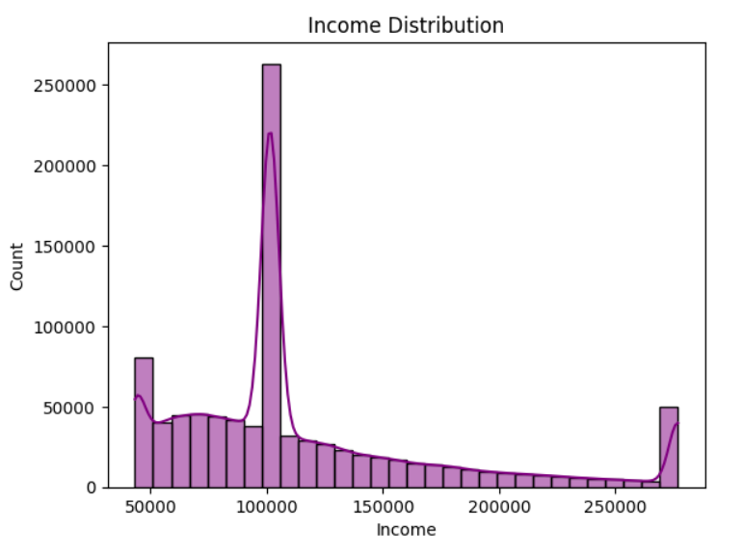
Age Distribution and Income Distribution

Slide 8
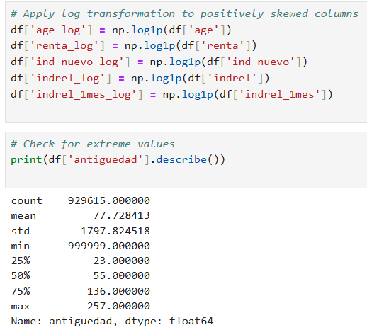
3. Feature Engineering
Derived meaningful features to enhance model performance: Log Transformations: Reduced skewness in income and age distributions.
Encoded Segments: Converted categorical segments into numeric labels for seamless machine learning.

Slide 9
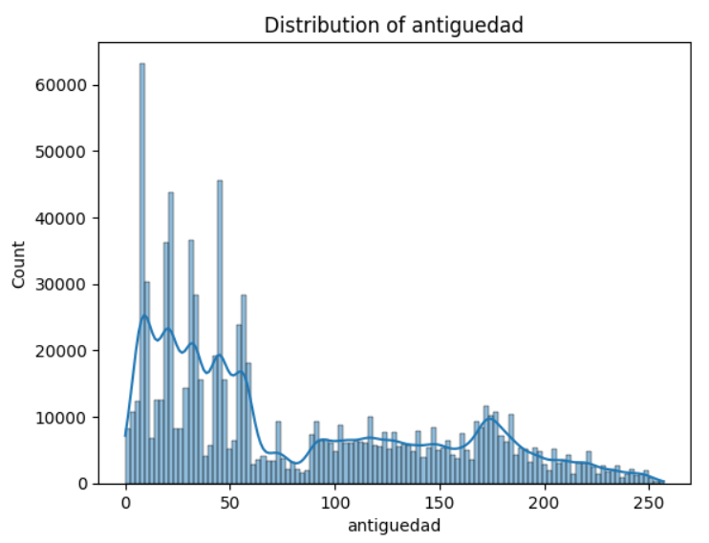
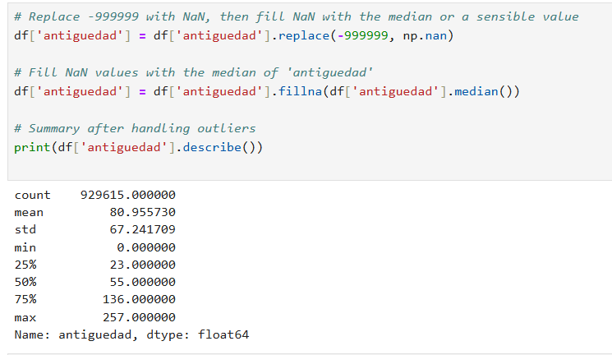

Slide 10
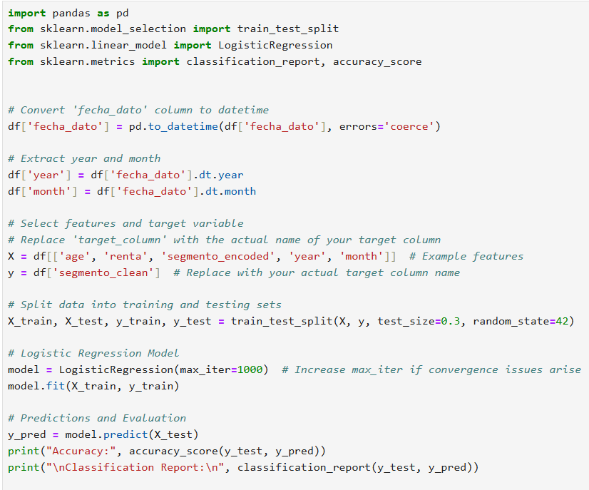
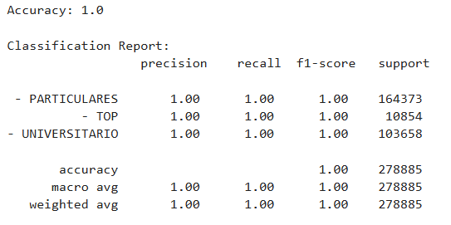
4. Machine Learning Models
Linear Model
We initially trained a Logistic Regression model as a baseline.
Performance: The linear model achieved an accuracy of 1.0, which, while impressive, required validation for robustness.

Slide 11
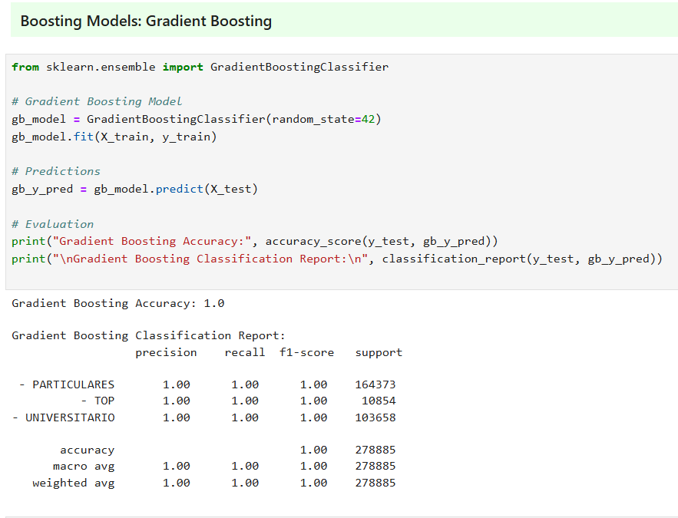
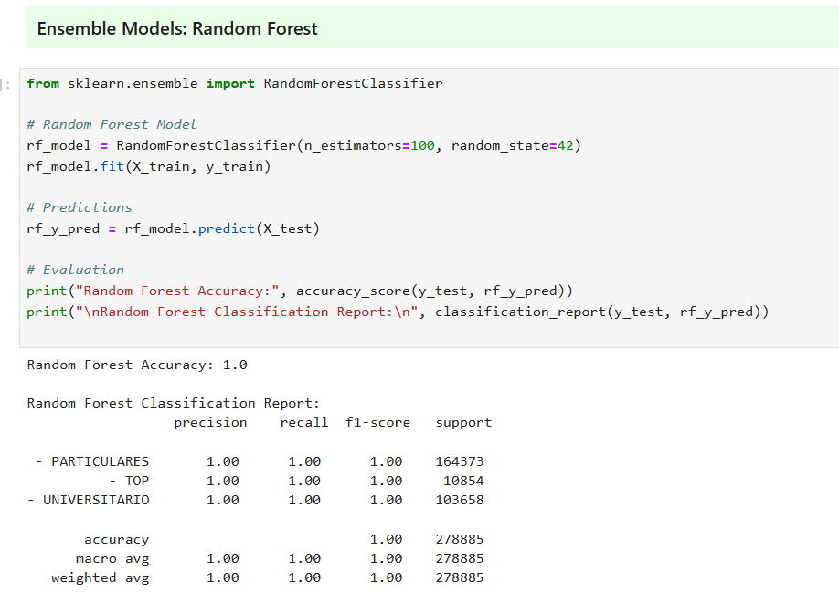
Additional Models

Slide 12
5. Evaluation and Insights
Accuracy Scores:
All models demonstrated strong performance, but the linear model consistently achieved perfect results.
Random Forest and XGBoost also performed exceptionally well, offering high interpretability.
Validation: Cross-validation techniques confirmed the reliability of the predictions and mitigated concerns about overfitting.

Slide 13
6. Challenges
Data Imbalance: Some customer segments, like TOP, had fewer entries, which could bias predictions. Resampling or weighting techniques were considered.
Perfect Accuracy: While the linear model's accuracy of 1.0 was ideal, we validated it thoroughly to rule out data leakage.

Slide 14
Conclusion
This project aimed to explore customer segmentation by predicting customer segments based on their attributes. Our primary goal was to utilize machine learning models to identify distinct customer groups accurately and derive actionable insights to enhance business strategies.

